Slide 1

DEPARTMENT OF ARTIFICIAL INTELLIGENCE AND DATA SCIENCE ACADEMIC YEAR 2025 - 2026 SEMESTER III ARTIFICIAL INTELLIGENCE LABORATORY MINI PROJECT REVIEW <CRYPTARITHMETIC PUZZLE SOLVER USING BACKTRACKING SEARCH>
REGISTER NUMBER | 2117240070045
NAME | Chidambaram D
YEAR | II
SECTION | A
FACULTY IN-CHARGE | Mrs. M. Divya

Slide 2
PROBLEM STATEMENT
Cryptarithmetic problems are puzzles where each letter represents a unique digit.
The goal is to find a valid mapping of letters to digits so that the arithmetic equation holds true (e.g., SEND + MORE = MONEY).
The project aims to build a Python-based solver using backtracking search to explore possible digit assignments.
The algorithm ensures that:
Each letter maps to a distinct digit.
No leading letter is assigned zero.
The arithmetic result is mathematically correct.
Expected result: The solver should correctly identify valid digit-letter mappings and can be extended with heuristics or a GUI.

Slide 3
THEORETICAL BACKGROUND
Cryptarithmetic puzzles are examples of Constraint Satisfaction Problems (CSPs) in Artificial Intelligence.
Each letter acts as a variable with a domain of digits (0–9).
Constraints:
All letters must have distinct digits.
The arithmetic equation must hold true.
Leading letters cannot be assigned zero.
The problem is solved using the Backtracking Search Algorithm, a form of Depth-First Search (DFS) that systematically explores possible assignments.
Constraint checking is applied at each step to prune invalid assignments early and reduce search space.
The approach demonstrates how AI techniques like search and constraint reasoning can solve combinatorial logic problems efficiently.

Slide 4
IMPLEMENTATION AND CODE
Link to code in Git-hub Repository
List | Git-hub Repository Links
Implementation of Code Link
Word Document Report Link
PPT Link

Slide 5
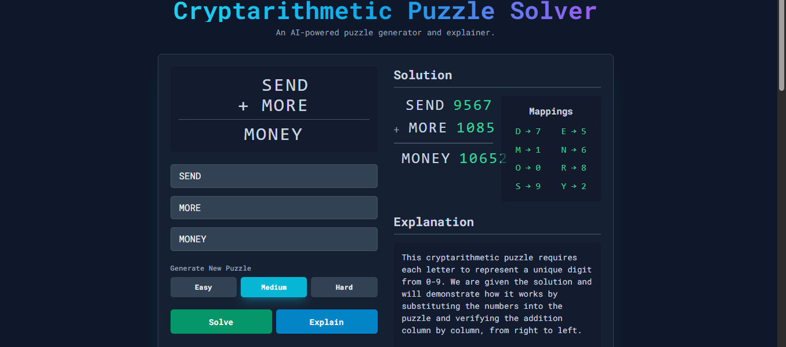
OUTPUT AND RESULTS

Slide 6
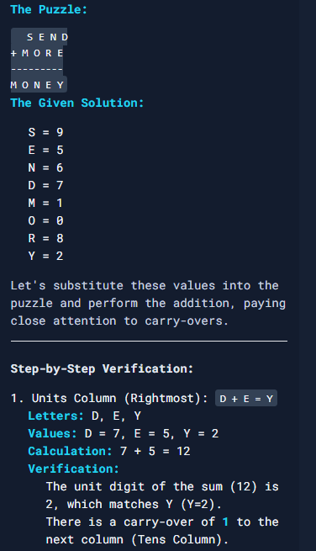
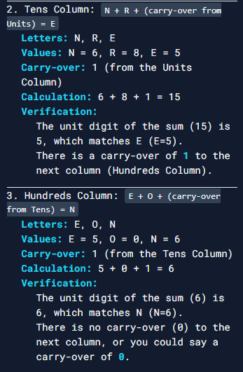

Slide 7
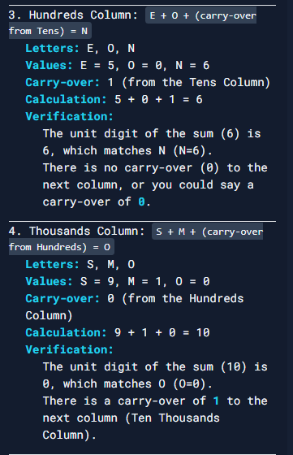
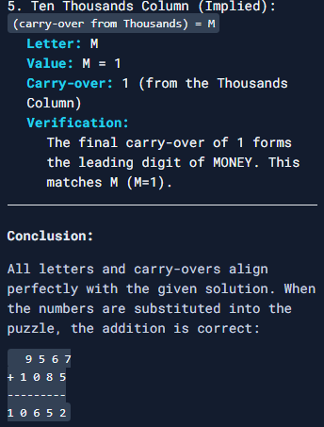

Slide 8
OUTPUT AND RESULTS
Results:
The developed system efficiently solves cryptarithmetic puzzles using the backtracking search algorithm. It accurately finds valid digit-letter mappings for all generated puzzles and displays clear explanations of the solutions. The automatic puzzle generator works effectively across three difficulty levels — Easy, Medium, and Hard — providing diverse examples to test the solver’s performance. The web interface offers an interactive and user-friendly environment for visualizing the solving process.

Slide 9
Future Enhancements:
Implement advanced heuristics such as MRV (Minimum Remaining Values) and forward checking to improve efficiency.
Add support for more complex operations like multiplication and subtraction-based cryptarithmetic puzzles.
Integrate machine learning or genetic algorithms to optimize search performance.
Develop a more advanced graphical interface with animations for educational demonstrations..

Slide 10
REFERENCES
Russell, S. & Norvig, P. — Artificial Intelligence: A Modern Approach, Pearson Education.
Rina Dechter — Constraint Processing, Morgan Kaufmann Publishers.
GeeksforGeeks — “Cryptarithmetic Problem using Backtracking” (Online article).
CP-Algorithms — “Constraint Satisfaction and Backtracking Search” (Online tutorial).
Various academic and online resources on AI-based problem solving and constraint reasoning.

